Slide 1
HACKATHON PROJECT:
TEAM :TN DATA STRIKERS
MEMBERS:1.G.RAMPRABHU
2.B.SURYA
DATE:04.11.2023

Slide 2
PROBLEM STATEMENT:
GDS Mart is currently facing a problem where a few key customers have not extended the annual contract due to service issues
TASK:
A.Create the metrics according to the metrics list
B.Create a dashboard according to the requirements provided by stakeholders in the business review meeting
C.Create a relevant insights.
THEME:
GDS Mart is a growing FMCG manufacturer headquartered in Gujarat, India. It is currently operational in three cities Surat, Ahmedabad and Vadodara. They want to expand to other metro/tier1 cities in the next 2 years.

Slide 3
PROCESS FLOW:
Import CSV data file(Extract)
Data Cleaning,Data Transformation(Using Power Query Editor)
DAX Measure for required field
Data Visualization(Cards,Charts)
Key Findings & Insights for the improvement

Slide 4
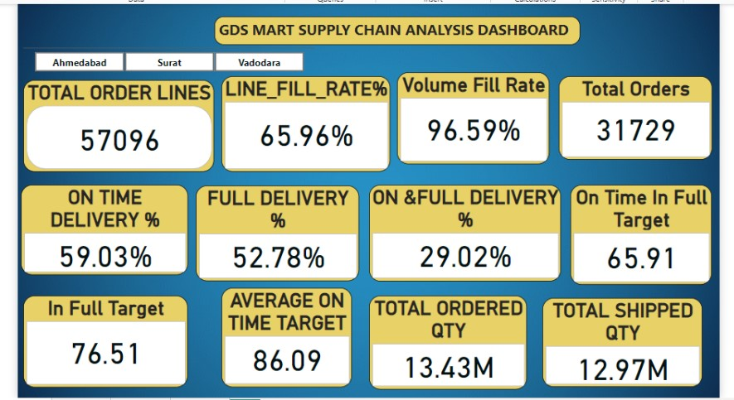
GDS MART DASHBOARD RESULTS

Slide 5
The following KPI’s for Overall city:
Total Order Qty:13.43M
Total Delivery Qty:12.97M
Target:
Avg.On Time %:86.09
Avg.IN-Full %:76.51
Avg.OTIF %:65.91
Actual:
ON Time %:59.03
IN-Full %:52.78
OTIF %:29.02

Slide 6
The following KPI’s for City Wise:Ahmedabad
Total Order Qty:4.61M
Total Delivery Qty:4.46M
Target:
Avg.On Time %:85.83
Avg.IN-Full %:77.33
Avg.OTIF %:66.50
Actual:
ON Time %:58.16
IN-Full %:54.20
OTIF %:29.33

Slide 7
The following KPI’s for City Wise:Surat
Total Order Qty:4.19M
Total Delivery Qty:4.05M
Target:
Avg.On Time %:86.27
Avg.IN-Full %:76.91
Avg.OTIF %:66.36
Actual:
ON Time %:61.21
IN-Full %:52.55
OTIF %:30.07

Slide 8
The following KPI’s for City Wise:Vadodara
Total Order Qty:4.62M
Total Delivery Qty:4.046M
Target:
Avg.On Time %:86.17
Avg.IN-Full %:75.33
Avg.OTIF %:64.92
Actual:
ON Time %:57.98
IN-Full %:51.56
OTIF %:27.78

Slide 9
Customer Vs Average delivery Hours KPI
City Wise:Ahmedabad
Target:
Avg.Delivery.Hours:10.70
Actual:
Avg.Delivery.Hours:
Impact Customers:
A.Cool Blue:30.64
B.Lotus Mart:31.03
C.Acclaimed Stores:30.55

Slide 10
Customer Vs Average delivery Hours KPI
City Wise:Surat
Target:
Avg.Delivery.Hours:9.10
Actual:
Avg.Delivery.Hours:
Impact Customers:
A.Lotus Mart:31.11
B.Acclaimed Stores:29.18

Slide 11
Customer Vs Average delivery Hours KPI
City Wise:Vadodara
Target:
Avg.Delivery.Hours:10.64
Actual:
Avg.Delivery.Hours:
Impact Customers:
A.Lotus Mart:30.29
B.Acclaimed Stores:30.40
C.Cool Blue:30.36

Slide 12
KEY FINDINGS:
All the cities customer Actual On-time,In-Full,OTIF not achieved against the target.
SIGNIFICANT CAUSE:
Actual delivery hours target not achieved for the specific customers :Lotus Mart,Cool Blue,Acclaimed Stores in all the cities.

Slide 13
DATA DRIVEN INSIGHTS:
New Warehouse to be fixed as a common point for all three cities to avoid delay in the delivery hours for the customers like Acclaimed Stores,Cool Blue,Lotus Mart.

Slide 14
THANK YOU

